Slide 1

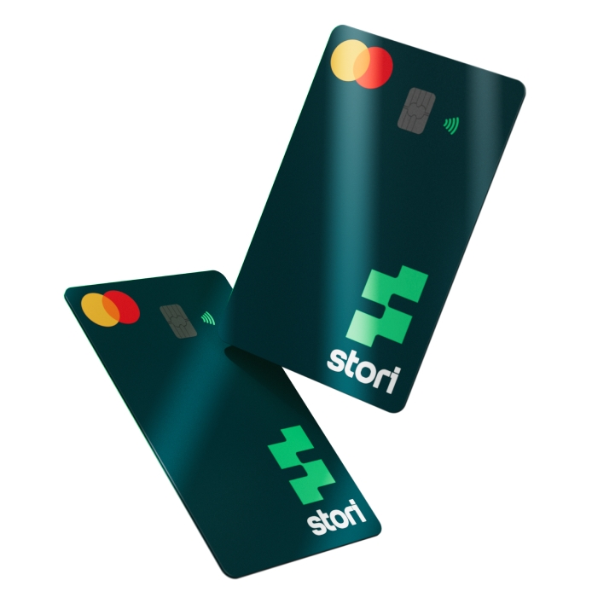
BA interview process: Home test
Part 1: Analysis of the state of the business
Factors against the profitability of the startup
Profitability during the next 12 months
Changes required to sustain the business
Part 2: Analysis of a collection strategy
KPIs
Impact delivered on overall business performance by this campaign
Improvements to this campaign
Ing. José de Jesús Bernal Mercado
Data Analyst

Slide 2
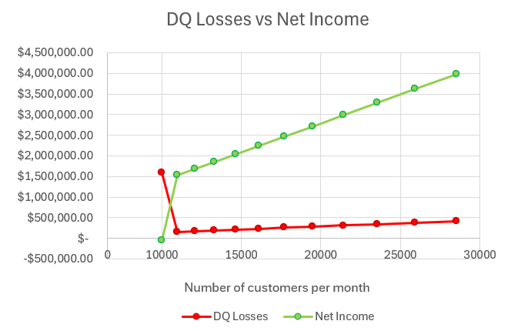
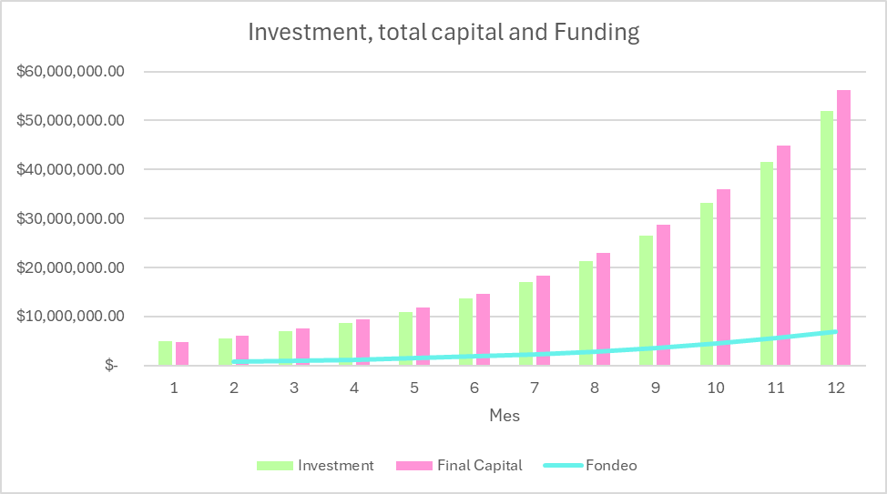
Analysis of the state of the business
Contigo B Analysis, DQ Losses Vs Net Income
Factors against the profitability of the startup
The accelerated growth of the company and the fixed DQ rate are two variables that can significantly impact the profitability of the startup. Operational costs directly influence net income, necessitating a search for avenues to reduce them effectively.
Major trends driving changes in net income the next 12 months
Contigo A Analysis, Investment, total capital and funding by month
Major trends impacting net income could include fluctuations in loan recovery rates, changes in market conditions affecting default rates, and adjustments in operational efficiency impacting costs. Regular monitoring and adaptation to these trends will be crucial in forecasting profitability accurately.

Slide 3

Analysis of the state of the business
Changes to sustain the business in the long run
Mitigate DQ Rates
In dynamic business environments, such as the financial sector, a fixed DQ rate indicates a lack of responsiveness to evolving risk factors. Implement measures to reduce the DQ rate, which stands at 13.50% consistently across months. This could involve refining risk assessment processes, enhancing customer screening procedures, and offering financial education programs to clients to reduce default risk.
Operational Efficiency
While the profitability of the startup shows an increasing trend over the months, operational costs per client remain constant at $30.00. There's an opportunity to optimize operational efficiency to reduce these costs, potentially through automation, renegotiating vendor contracts, or streamlining processes.

Slide 4
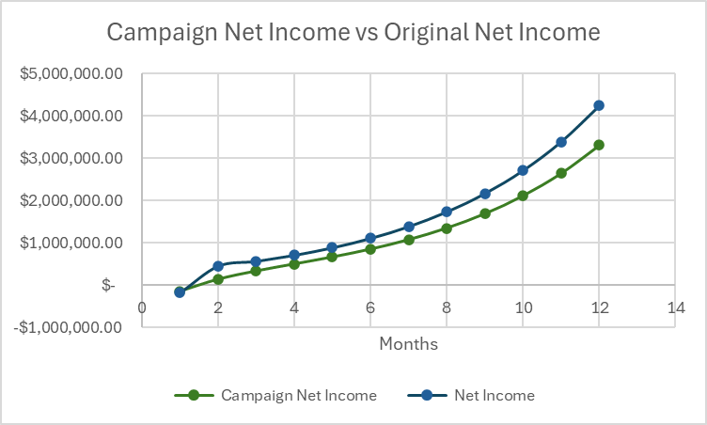
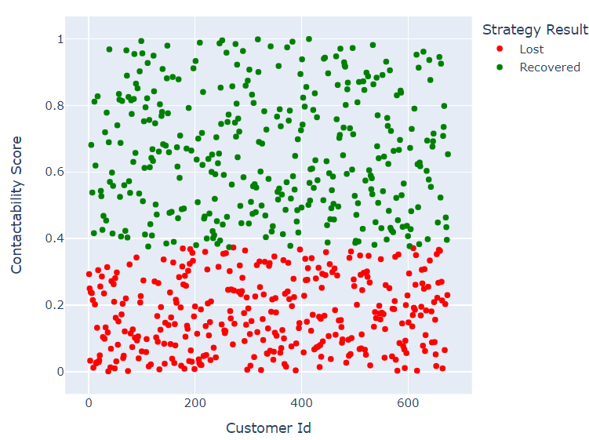
Analysis of strategy collection
KPIs | Results
Recovered accounts | 341 Accounts
Recovered total debt. | $341,000
Revenue coming from collected interest. | $51,150
Total campaign cost. | $20,250
DQ losses coming from uncollected total debt. | $334,000
Collections income. | $371,900
Contigo A Analysis, Net Income with/out Campaign
KPIs Month 1 of Campaign with Contigo A
Impact delivered on overall business performance by this campaign
Despite having recovery in the first month and the company continuing to be profitable, making the comparison with the data without a campaign we realize that because we always have a fixed DQ rate the campaign strategy provides us with less net income, since new debtor clients would always be added to reach 13.5%. Our focus should be on reducing the DQ rate or seeking its dynamism.
Contactability Score per client and its classification

Slide 5


BA interview process: Home test
Ing. José de Jesús Bernal Mercado
Data Analyst
bernal.mercado.josedejesus@gmail.com

